Slide 1

DEPARTMENT OF COMPUTER SCIENCE AND ENGINEERING
Project name : Smart Water Fountains
Team name : Proj_224781_Team_2
Team members :
NISHAN K M(113321104068)
PARAMESWARAN J(113321104069)
PATURU SUNEEL CHOWDARY(113321104072)
PAVANKUMAR V(113321104073)

Slide 2
Project Definition:
The project aims to enhance public water fountains by implementing IoT sensors to control water flow and detect malfunctions. The primary objective is to provide real-time information about water fountain status to residents through a public platform. This project includes defining objectives , designing the IoT sensor system, developing the water fountain status platform, and integrating them using IoT technology and python.

Slide 3
Objectives:
Smart water fountains using IoT (Internet of Things) and Python can serve various objectives aimed at enhancing the efficiency, accessibility, and sustainability of water fountains.
Water Conservation:
Monitor water usage and flow rates in real-time.
Implement automatic shut-off when water is not in use.
Energy Efficiency:
Utilize sensors to detect human presence and activate the fountain's water flow and lighting only when people are nearby.
Maintenance Alerts:
Use IoT sensors to monitor the health of the fountain components. Send maintenance alerts when issues like pump failures or clogged filters are detected.
Security and Access Control:
Secure IoT devices and communication to prevent unauthorized access or tampering.
Implement access controls to limit who can interact with the fountain remotely.

Slide 4
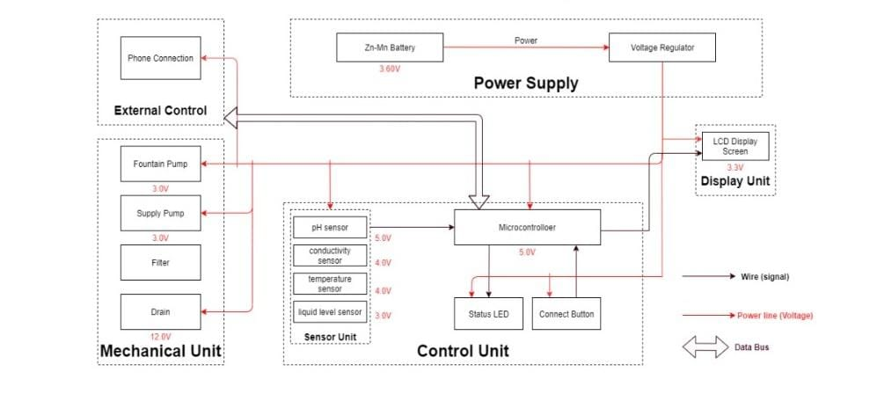
IoT Sensor Design:

Slide 5
IoT Sensor Design:
Smart water fountains involves the creation of sensor-based systems to monitor and control various aspects of water fountains.
These sensors collect data such as water level, quality, temperature, and pump status, which is then transmitted to a central system for analysis and control.
The key components of IoT sensor design for smart water fountains include selecting appropriate sensors, microcontrollers with connectivity options, power supplies, data processing and transmission mechanisms, cloud platforms for data storage and management, user interfaces for remote control, and security measures to protect data and device access.
These systems improve the efficiency, maintenance, and user experience of water fountains while ensuring compliance with relevant regulations and standards.

Slide 6
Real-Time Transit Information Platform:
A Real-Time Transit Information Platform (RTI) for the smart water fountain project can be used to provide residents with real-time information about the status of the water fountains in their area. This information can include the following:
Whether the water fountain is operational or not
The water quality at the water fountain
The water temperature at the water fountain
The estimated time of arrival of the next maintenance crew
This information can be displayed on a variety of platforms, such as a website, a mobile app, or a digital display at the water fountain itself.
Implement an alerting system that notifies administrators when water quality is below a certain threshold or when a fountain requires maintenance.

Slide 7
Integration Approach:
The integration of the IoT sensor system involves connecting and coordinating various components to ensure seamless operation.
Communication Protocols: It involves protocols for communication between IoT sensors and the central platform.
API Design: This develops standardized APIs for secure data exchange between sensors and the monitoring platform.
Data Serialization: It implements a common data serialization format (ex: JSON) for consistent information exchange.
IoT Gateway: It aggregates data from sensors, handling protocol translation and preprocessing.
Cloud Platform Integration: Host the central monitoring platform on a cloud service for analytics.

Slide 8
THANK YOU!

